Slide 1
[Name of organization being presented to]
[Date]
Notes:
Hello, my name is _________, and I am a Volunteer with the World Partnership Walk.
For RETURNING Team/Participants: Thank you for the opportunity to speak with you today. We truly appreciate your past support of the Walk [specify the type of support i.e. as a team, sponsor, donor, etc.] and I'm excited to talk to you about the way that your support is helping transform lives.
For NEW Teams/Participants: Thank you kindly for the opportunity to speak with you today. I’m very happy to meet all of you and excited to talk to you about the tremendous positive impact that Canada and Canadians are contributing to in our global community.
[SPEAKER NOTE:]
Please customize your title as required.
Speakers are encouraged to customize presentations based on audiences and speaking times by keeping or removing slides as required.]

Slide 2
Notes:
[SPEAKER NOTE: If there is time, start with the group activity explained below]
We live in a time when we are more connected to other parts of the world than we have ever been before.
What happens in other parts of the world often has direct implications on our lives here in Canada (social and political unrest, economic shifts, wars, health threats, etc.).
Our global community is not something that simply exists beyond our borders, it is rather something that we are very much part of.
QUESTIONS:
What kind of global community do we want to live in? A community that is economically stable? Peaceful? Secure? Healthy? Prosperous? Collaborative? United?
What are we doing to contribute to this kind of global community?
GROUP ACTIVITY (IF THERE IS TIME):
Ask audience members to get into pairs (or small groups, depending on the size of the audience) and find as many connections as they can to countries outside of Canada.
After a few minutes, briefly review the connections as a group. You may want to bring their attention to connections that they may not have identified, such as connections through travel, music, foods, sports, belongings, business affiliations, ancestry, etc.
Conclude the exercise by stating that we live in a time where we are more connected to other parts of the world than we have ever been before.

Slide 3
Global development is working….
1 billion people out of poverty (50% down in 20 years)
Mortality rates of children under 5 down by over 50% since 1990
But there is much more to be done…
836 million still live in extreme poverty
16,000 children under 5 die every day
SOURCE:
United Nations Millennium Development Goals Report 2015
United Nations Sustainable Development Goals 2016
Global Development
IS Working
Notes:
International development is a means through which we can contribute to a prosperous global community.
Global development has improved millions of lives around the world.
On a global scale, we are part of a movement that reduced global poverty rates by 50% between 1990 and 2010, and lifted hundreds of millions of people out of poverty.
What does that look like for communities and individuals? It means that parents have enough nutritious food to feed their children, each and every day. It means that children complete school with the skills to make a better future. Development helps communities address issues such as clean water, steady employment and quality health care.
Between 1990 and 2010, mortality rates for children under the age of 5 were also reduced by 50%.
BUT despite these advances, almost 836 million people still live in extreme poverty - that means that they live on less than $1.25 per day – and according to the United Nations, every day in 2015, 16,000 children under five continued to die, mostly from preventable causes. The overwhelming majority of people living on less than $1.25 a day belong to two regions: Southern Asia and sub-Saharan Africa.
The ISSUE:
The reality is that today, hundreds of millions of citizens continue to live in extreme poverty and are denied a life of dignity. SO, while development is working, the fight against poverty is ongoing.
[If there is time, mention the bullets below]
There are rising inequalities within and among countries.
There are enormous disparities of opportunity, wealth and power.
Gender inequality remains a key challenge.
Unemployment, particularly youth unemployment, is a major concern.
Global health threats, more frequent and intense natural disasters, spiralling conflict, violent extremism, terrorism and related humanitarian crises and forced displacement of people threaten many communities around the world.
SOURCE:
United Nations Millennium Development Goals Report 2015
United Nations Sustainable Development Goals 2016

Slide 4
The Opportunity
Notes:
In the face of the challenges that our global community is faced with, there is an immense opportunity to make a difference in the lives of millions of people who live in poverty around the world.
In the face of challenges, there IS hope for a brighter future and prosperity for all of humanity.
Our interconnectedness presents us with a great opportunity to accelerate human development and to be a positive force of change in our global community by investing our time, resources and knowledge in smart development solutions that help alleviate poverty and improve the quality of life for communities in some of the poorest regions of the world.
In turn, we are contributing to a more prosperous, economically stable, secure, healthy, united, and thriving global community for us all.

Slide 5
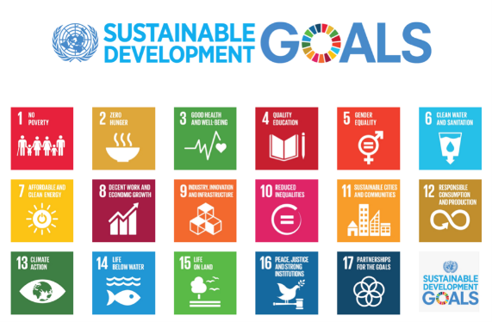
WE ARE PART OF A GLOBAL MOVEMENT
Notes:
This opportunity has inspired leaders and countries to come together and improve the conditions of our global community.
United Nations Sustainable Development Goals (SDGs):
On September 25th 2015, countries around the world (193) adopted a set of goals to end poverty, protect the planet, and ensure prosperity for all, as part of a new sustainable development agenda. These global goals are for all countries and all people.
As you will note, “No Poverty” is number one on the list. If you expand on this goal, section 1.1 says: “By 2030, eradicate extreme poverty for all people everywhere, currently measured as people living on less than $1.25 a day”
SO, we are part of a global movement of thought leaders, change makers and ordinary people who want to see an end to global poverty.
SOURCE: https://sustainabledevelopment.un.org/?menu=1300

Slide 6
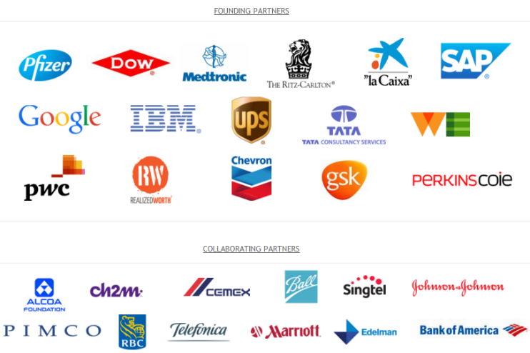
Notes:
[SPEAKER NOTE: This slide is for CORPORATE AUDIENCES. DELETE this for non-corporate audiences]
This is something that is important to the corporate world as demonstrated through IMPACT 2030.
IMPACT 2030 is a business-led global collaboration between the United Nations, the private sector and civil society organizations, created to mobilize corporate volunteers to directly and substantially contribute to achieving the United Nations’ Sustainable Development Goals.
Here is a list of the companies that have joined IMPACT 2030. They are engaging their employees in volunteering activities to help achieve the objectives of sustainable development.

Slide 7
Change IS Possible
We are globally interconnected
Global development works
There is a NEED and OPPORTUNITY to do more
Notes:
We are interconnected as a global community and have the capacity to contribute to positive change.
There is a larger global movement of leaders, change makers and ordinary people who want to see an end to global poverty.
Global development is working and poverty levels have dropped significantly in the past few decades.
Hundreds of millions of citizens still live in extreme poverty.
SO, there is an ongoing need and tremendous opportunity for all of us to be a part of the solution to end poverty in our lifetime.

Slide 8
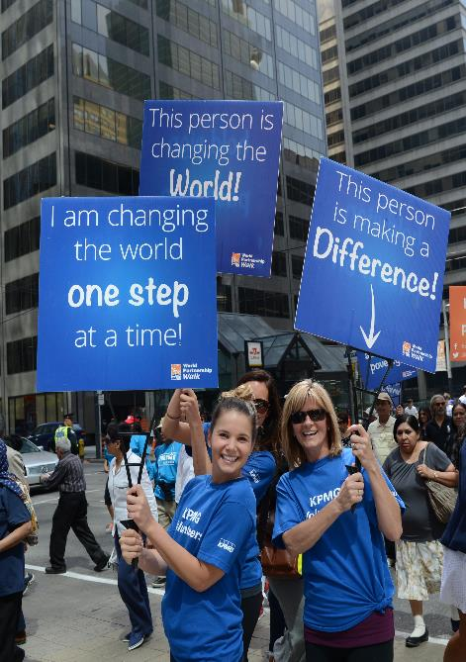
World
Partnership Walk
An initiative of:
Canada’s largest event to fight global poverty
10 cities across Canada
A movement of globally minded Canadians that started in 1985
Notes:
The World Partnership Walk is a fantastic vehicle through which Canadians can put their global citizenship into action and be a force of positive change in their local and global community
The Walk is an initiative of the Aga Khan Foundation Canada — a registered Canadian charity and non-profit international development agency that works with communities in developing regions of the world, to find sustainable solutions to the complex problems of global poverty. In Canada, AKFC raises funds, taps into Canadian expertise to strengthen its development work, builds partnerships with Canadian institutions, and promotes discussion and learning on global issues.
The Walk is Canada’s largest annual event dedicated to raising funds and awareness to end global poverty.
It is a national movement of tens of thousands of Canadians who come together to have a global impact.
For the last 30 years, thousands of Canadians from across the country have joined the World Partnership Walk to make a difference beyond our borders — and they ARE making a difference.

Slide 9
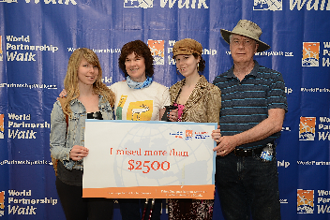
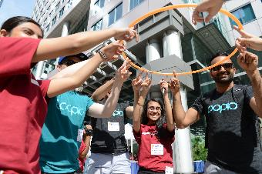
World
Partnership Walk
Last year, 40,000 Canadians stepped forward
We raised $7 million last year and over $95 million to date
Every dollar donated goes to long-term, sustainable solutions to poverty
Notes:
We’ve had a big impact in Canada and the numbers show it.
FOR 2015 PARTICIPANTS AND SPONSORS
Last year the Walk attracted around 40,000 thousand Canadians
You helped raise $7 million to end global poverty last year and we’ve raised over $95 million to date
OPTIONAL: In {city name] alone, $XX was raised and your team raised $XX
When you support the World Partnership Walk, AKFC invests 100% of all donations in international development programs
Funds raised by the Walk also help Aga Khan Foundation Canada to leverage additional support from major donors like the Government of Canada through Global Affairs Canada. This means that the impact of every dollar you raise is multiplied many times over.
FOR POTENTIAL PARTICIPANTS AND SPONSORS
Last year the Walk attracted around 40,000 thousand Canadians
People just like you helped raise $7 million to end global poverty last year and we’ve raised over $95 million to date
OPTIONAL: Your city alone raised $ XX.
When you support the World Partnership Walk, AKFC invests 100% of all donations in international development programs
Funds raised by the Walk also help Aga Khan Foundation Canada to leverage additional support from major donors like the Government of Canada through Global Affairs Canada. This means that the impact of every dollar you raise is multiplied many times over.

Slide 10
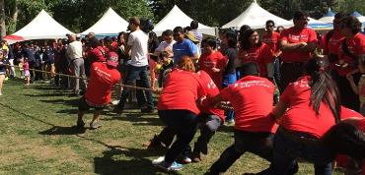
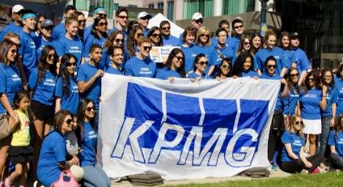
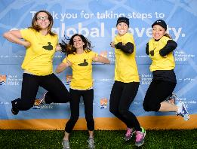
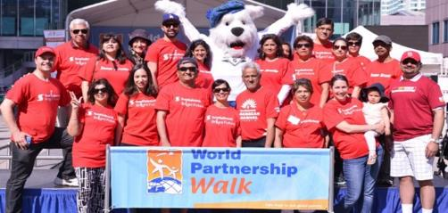
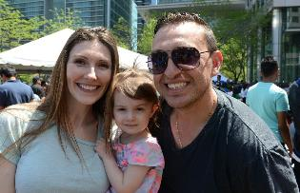
Notes:
The Walk is a family friendly event for everyone!
It’s a fun day to connect with your local community and enjoy good food, entertainment and fun activities.
It’s also a terrific opportunity to learn more about the projects that you are supporting and to celebrate Canada’s contribution to the world.

Slide 11
Focus Areas
Education
Health
Rural Development
Civil Society
Notes:
[SPEAKER NOTE: Depending on the audience and time available, speakers may choose to focus on one or two specific focus areas instead all four (education, health, rural development, civil society). Some slides may be removed to customize the presentation for your audiences. For example, if you are speaking to a group of educators, you may want to focus on the education slides while a company in the health sector may be more interested in health-related programs.]
Sometimes, we take what we have for granted — going to school, seeing the doctor if we’re sick, having enough to eat, having opportunities to earn a good living, and so much more.
Many communities in the developing world don’t have access to even basic resources. That’s why foundation is working to improve millions of lives by enabling women and men to lift themselves and their children out of poverty, creating strong, vibrant communities and restoring that spark of hope that unites all of humanity.
AKFC tackles complex causes of poverty through a focus on four critical areas:
Education – strengthening quality and access to life-long learning opportunities, from early childhood to university education, to ensure that communities and countries have leaders equipped with the tools, knowledge and confidence to drive positive change.
Heath – investing in the local institutions and professionals required to deliver world-class health care, even in remote areas.
Rural development — improving agriculture and food security, promoting a range of economic opportunities for women and men, and protecting the often fragile environments and natural resources found in remote areas
Civil society — empowering local citizens and institutions to lead development – making communities stronger and more resilient in times of change.
The following slides are only a few highlights of AKFC’s work and how the impact is transforming lives.

Slide 12
Educating
Girls and Women
in Afghanistan
10,000 educators trained
175,000 girls attending school
Early childhood development
Mothers’ literacy groups
Notes:
EDUCATION EXAMPLE #1:
CONTEXT:
The most successful development programs equip women and girls with the relevant knowledge and skills necessary for them to become a vital part of their community’s social and economic networks. Nowhere is this more important than Afghanistan, where – despite remarkable progress in getting girls back into the education system -- only 1 in 10 Afghan women can read or write.
PROJECT IMPACT:
Between 2008 and 2015, an AKFC program has:
Trained and mentored 10,000 teachers in Afghanistan
Ensured that 175,000 more girls could attend school and receive the support they need to complete their studies
Provided early childhood development for thousands of preschoolers
Empowered thousands of mothers through access to Mothers’ literacy groups.

Slide 13
Educating
Young Minds
in East Africa
850 community libraries have been established
Over 2,800 parents have learned the importance of reading with children
Notes:
EDUCATION EXAMPLE #2:
CONTEXT:
The most successful development programs equip children with the relevant knowledge and skills necessary for them to become a vital part of their community’s social and economic development. A fantastic example of this is the “Reading for Children” initiative in East Africa. The initiative, supported by Aga Khan Foundation Canada and the Government of Canada, works with communities to ensure young children are exposed to illustrated books, develop their language abilities, and have enjoyable early learning experiences.
PROJECT IMPACT:
In East Africa, this program has:
Established 850 community libraries
Taught more than 2,800 parents in Kenya, Tanzania, and Uganda about the importance of reading with their children

Slide 14
Improving Maternal, Newborn, and Child Health in Tanzania
36 health facilities improved
1,500 health workers trained
27,000 babies born safely
Notes:
Despite unprecedented advances in global health, citizens of the developing world continue to suffer from lack of access to high-quality, dependable medical treatment and the spread of preventable diseases. AKFC supports a broad range of health initiatives that enhance healthcare institutions and services, train and equip professionals with the skills to provide better quality care, and improve the health of both women and men – with special attention to maternal and child health.
HEALTH EXAMPLE #1
CONTEXT:
Unfortunately, in many parts of Asia and Africa, women don’t have access to the facilities and services they require. Some women must travel long distances – often walking – for hours to get to a clinic. Too often, they don’t make it in time to get the help they need. In Tanzania, one in 38 women is at risk of maternal death. Of those who survive, many are at risk of contracting illnesses or developing a disability.
PROJECT IMPACT:
In Tanzania, between 2012 and 2015, an AKFC program helped:
Improve 36 heath facilities
Trained 1,500 local health workers
Ensured 27,000 more babies could be born safely.
In the Tanzanian context, the positive impact of this project is quite transformative in the lives of many women and and their families.

Slide 15
Improving Maternal, Newborn, and Child Health in Afghanistan
19,854 children and 12,000 women treated for malnutrition
400,000 Afghans have access to hospital services
Notes:
HEALTH EXAMPLE #2
CONTEXT:
Suicide attacks, earthquakes, and assaults on girls in school dominate international news from Afghanistan. But there is a greater danger to life rarely mentioned in the headlines: pregnancy. One out of every 52 women in Afghanistan will die due to complications in pregnancy and childbirth. The statistics are particularly grim in rural areas. BUT, in 4 out of 5 cases, death is preventable with the timely help of a skilled professional.
PROJECT IMPACT:
19,854 children under 5 received treatment for severe malnutrition at 11 health facilities in northern Afghanistan.
Over 12,000 pregnant women and 5,000 breastfeeding women also received nutrient supplements and treatment for acute malnutrition.
In Bamyan province, in northern Afghanistan, a small district hospital – where 15 out of 35 beds were in tents – is being transformed into a modern, 100-bed health facility offering a wide range of services which will reach 400,000 Afghans – 70% of whom are women and children – by 2016.

Slide 16
Improving Food Security and Incomes in Mozambique
Reach 35,000 households
Over 100 Farmer Field Schools training thousands of producers in improved farming methods
Nutrition groups helping thousands of households improve their diet
140% more women and
men have cash savings
Notes:
RURAL DEVELOPMENT: Reducing poverty in remote, resource-poor or degraded environments is central to AKFC’s rural development programs. These programs are rooted in a simple but potent idea: social mobilization.
CONTEXT:
Today, almost 800 million people in developing countries don’t have enough nutritious food to eat every day (Source: https://www.wfp.org/hunger/stats). In Cabo Delgado, Mozambique – one of the poorest regions in one of the poorest countries in the world – AKFC has been working with local partners to address multiple challenges that rural communities face: hunger and malnutrition, lack of access to markets and financial services, few economic opportunities, and the inability of farmers to produce enough food to eat.
PROJECT IMPACT:
Since the year 2010, this program:
Reached 35,000 households
Established over 100 Farmer Field Schools which helped train thousands of producers in improved farming methods
Improved nutrition in the community
Expanded livelihood opportunities and fostered community-based savings groups that enable members to access finances in times of need or to invest in the growth of their farms and businesses.

Slide 17
Strengthening Employability and Community Engagement in Pakistan
189,000 young people ready to engage in the workforce and their communities
Notes:
CIVIL SOCIETY: While governments in Asia and Africa are major players in driving human development, civil society organizations have an equally critical role in ensuring development is equitable, sustainable, responsive and innovative. AKFC partners with local civil society organizations to equip them with skills to improve their effectiveness, governance and standards, and to foster positive relationships with government, their communities and the private sector.
PROJECT IMPACT:
In the remote, high mountain areas of northern Pakistan, AKFC helps young people better their prospects by working with local organizations, engaging them in the work force, community institutions and decision-making bodies. By the end of this program in 2016:
189,000 youth will have the knowledge and skills to forge a secure and prosperous future for their families and communities.
These are just four of the projects AKFC supports, and examples of the tremendous impact that the money raised through the Walk has had on the lives of thousands of people.

Slide 18
AKFC and World Partnership Walk
YouTube channel
Notes:
Visit and subscribe to our World Partnership Walk and Aga Khan Foundation Canada YouTube page to learn more about our projects and impact.
SPEAKER NOTE:
If time permits and there is wifi access, you can embed a link to one of the videos on our YouTube channels.
Sample videos:
Breaking the Cycle of Poverty: Healthier Mothers, Healthier Children
https://youtu.be/e0up8_voIDU
Breaking the Cycle of Poverty: A Strong Foundation for Every Child
https://youtu.be/Iz2aXNMrnXk
Breaking the Cycle of Poverty: Sowing the Seeds of Food Security
https://youtu.be/nuvGoax2YSw

Slide 19
If you believe that…
No one should live in extreme poverty
Someone like you can make an impact
Global development works
We can end global poverty
Notes:
If you believe that no one should live in extreme poverty,
If you believe that Canadians – people like you and I – can play a role to better the conditions of our global community,
If you believe that global development works,
If you want to help end global poverty,
We invite you to Step Forward

Slide 20
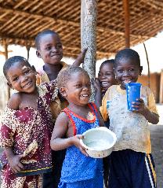
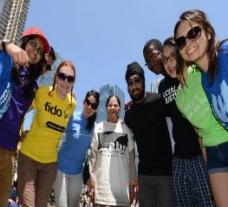
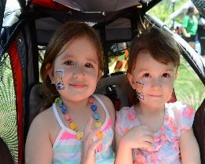
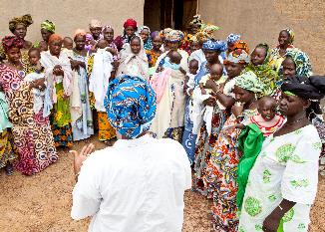
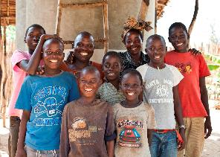
Step Forward and Transform Lives
Start or Join a Team
Donate
Come out to the Walk
Notes:
There are many ways to lend your support and get involved:
Start or Join a Team
Donate (as an individual or company)
Come out to the Walk on [insert Walk date in your city]
SPEAKER NOTE: You are encouraged to customize your Call to Action for different audiences. See below for examples:
STUDENT AUDIENCE
High School – Register a school team to put your global citizenship into action, engage your classmates, and earn volunteer hours.
University & College – Register a University & College team to contribute to positive global change and show future employers your teambuilding skills.
GENERAL AUDIENCE & PARENTS
Family & Friends Team – Make your mark as a community leader and spend quality time with friends and family by working as a team.
Tots & Tykes Team – Teach your kids about teamwork and the importance of helping others.
CORPORATE AUDIENCE
Start a Workplace Team
Join as a Corporate Sponsor or Donor
BENEFITS FOR COMPANY
Our workplace programs are a great way to:
Enhance corporate marketing, branding, and networking objectives
Be recognized as a globally-minded and community-oriented company
Engage employees and customers in a meaningful cause
Connect with highly desirable, influential, and diverse Walk audiences
Improve talent retention and productivity
BENEFITS TO PROFESSIONALS/EMPLOYEES (Prospective Team Captains or Team Members)
Expand your professional and social network.
Build your brand as a talented professional who is passionate about building scale and making a positive social impact locally and globally.
Obtain valuable leadership experience and learn about sustainable global development initiatives at a well-respected international development organization.
Participate in a fun, family event that you can get your colleagues, friends and family involved in.

Slide 21
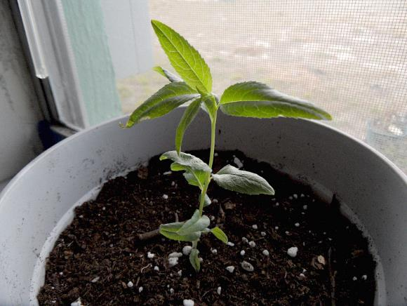
The most powerful thing that any person can possess is….HOPE
Notes:
QUESTION: What words come to mind when you see this photo? [Give the audience a chance to respond]
ANSWER: This is an almond seedling. The almond tree is a species of tree native to the Middle East and South Asia. It begins to bear an economic crop in the 3rd year after planting. The tree reaches full bearing 5-6 years after planting. When a farmer plants this seed, they are planning ahead for the next 3-6 years. The farmer is working towards a fruitful future.
If we can leave you with one thought, it’s this: The most powerful thing that any person can possess is hope. The money we raise each year through the World Partnership Walk restores the spark of hope that unites all of humanity.

Slide 22
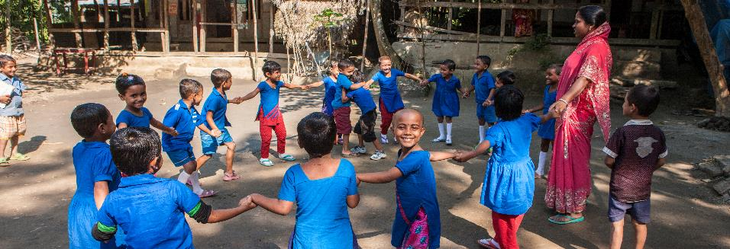
Join us at this year’s Walk:
City
Date
Location
www.worldpartnershipwalk.com
Notes:
We invite you to step forward with us to continue to instill this HOPE for families and communities who really need it.
Visit us at worldpartnershipwalk.com and feel free talk to me today. I’ll be here for another [xx] minutes.
Thank you for your time and the opportunity to connect with you. I hope we can do this together.

